Slide 3
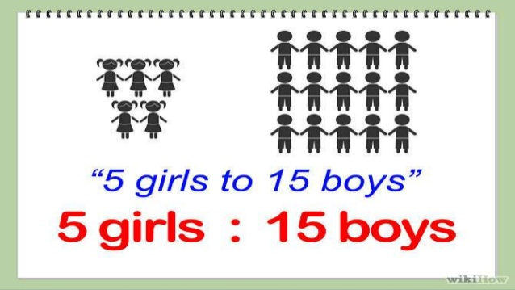

Slide 4
EXAMPLE
QUES: FIND THE RATIO OF 3KM TO 300M
SOL:FIRST CONVERT BOTH THE DISTANCES TO SAME UNIT
3KM=3 X 1000 M=3000 M
THUS THE REQUIRED RATIOS, 3 KM :300M IS 3000:300=10:1

Slide 10
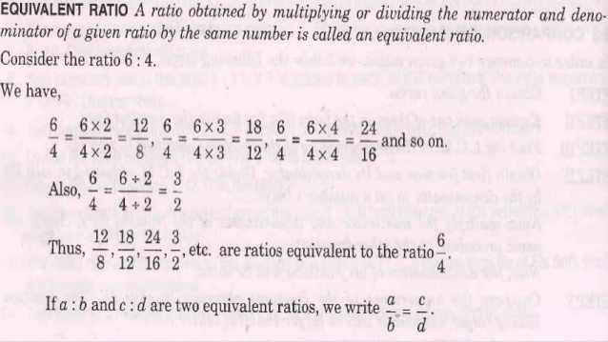

Slide 16
